Slide 1
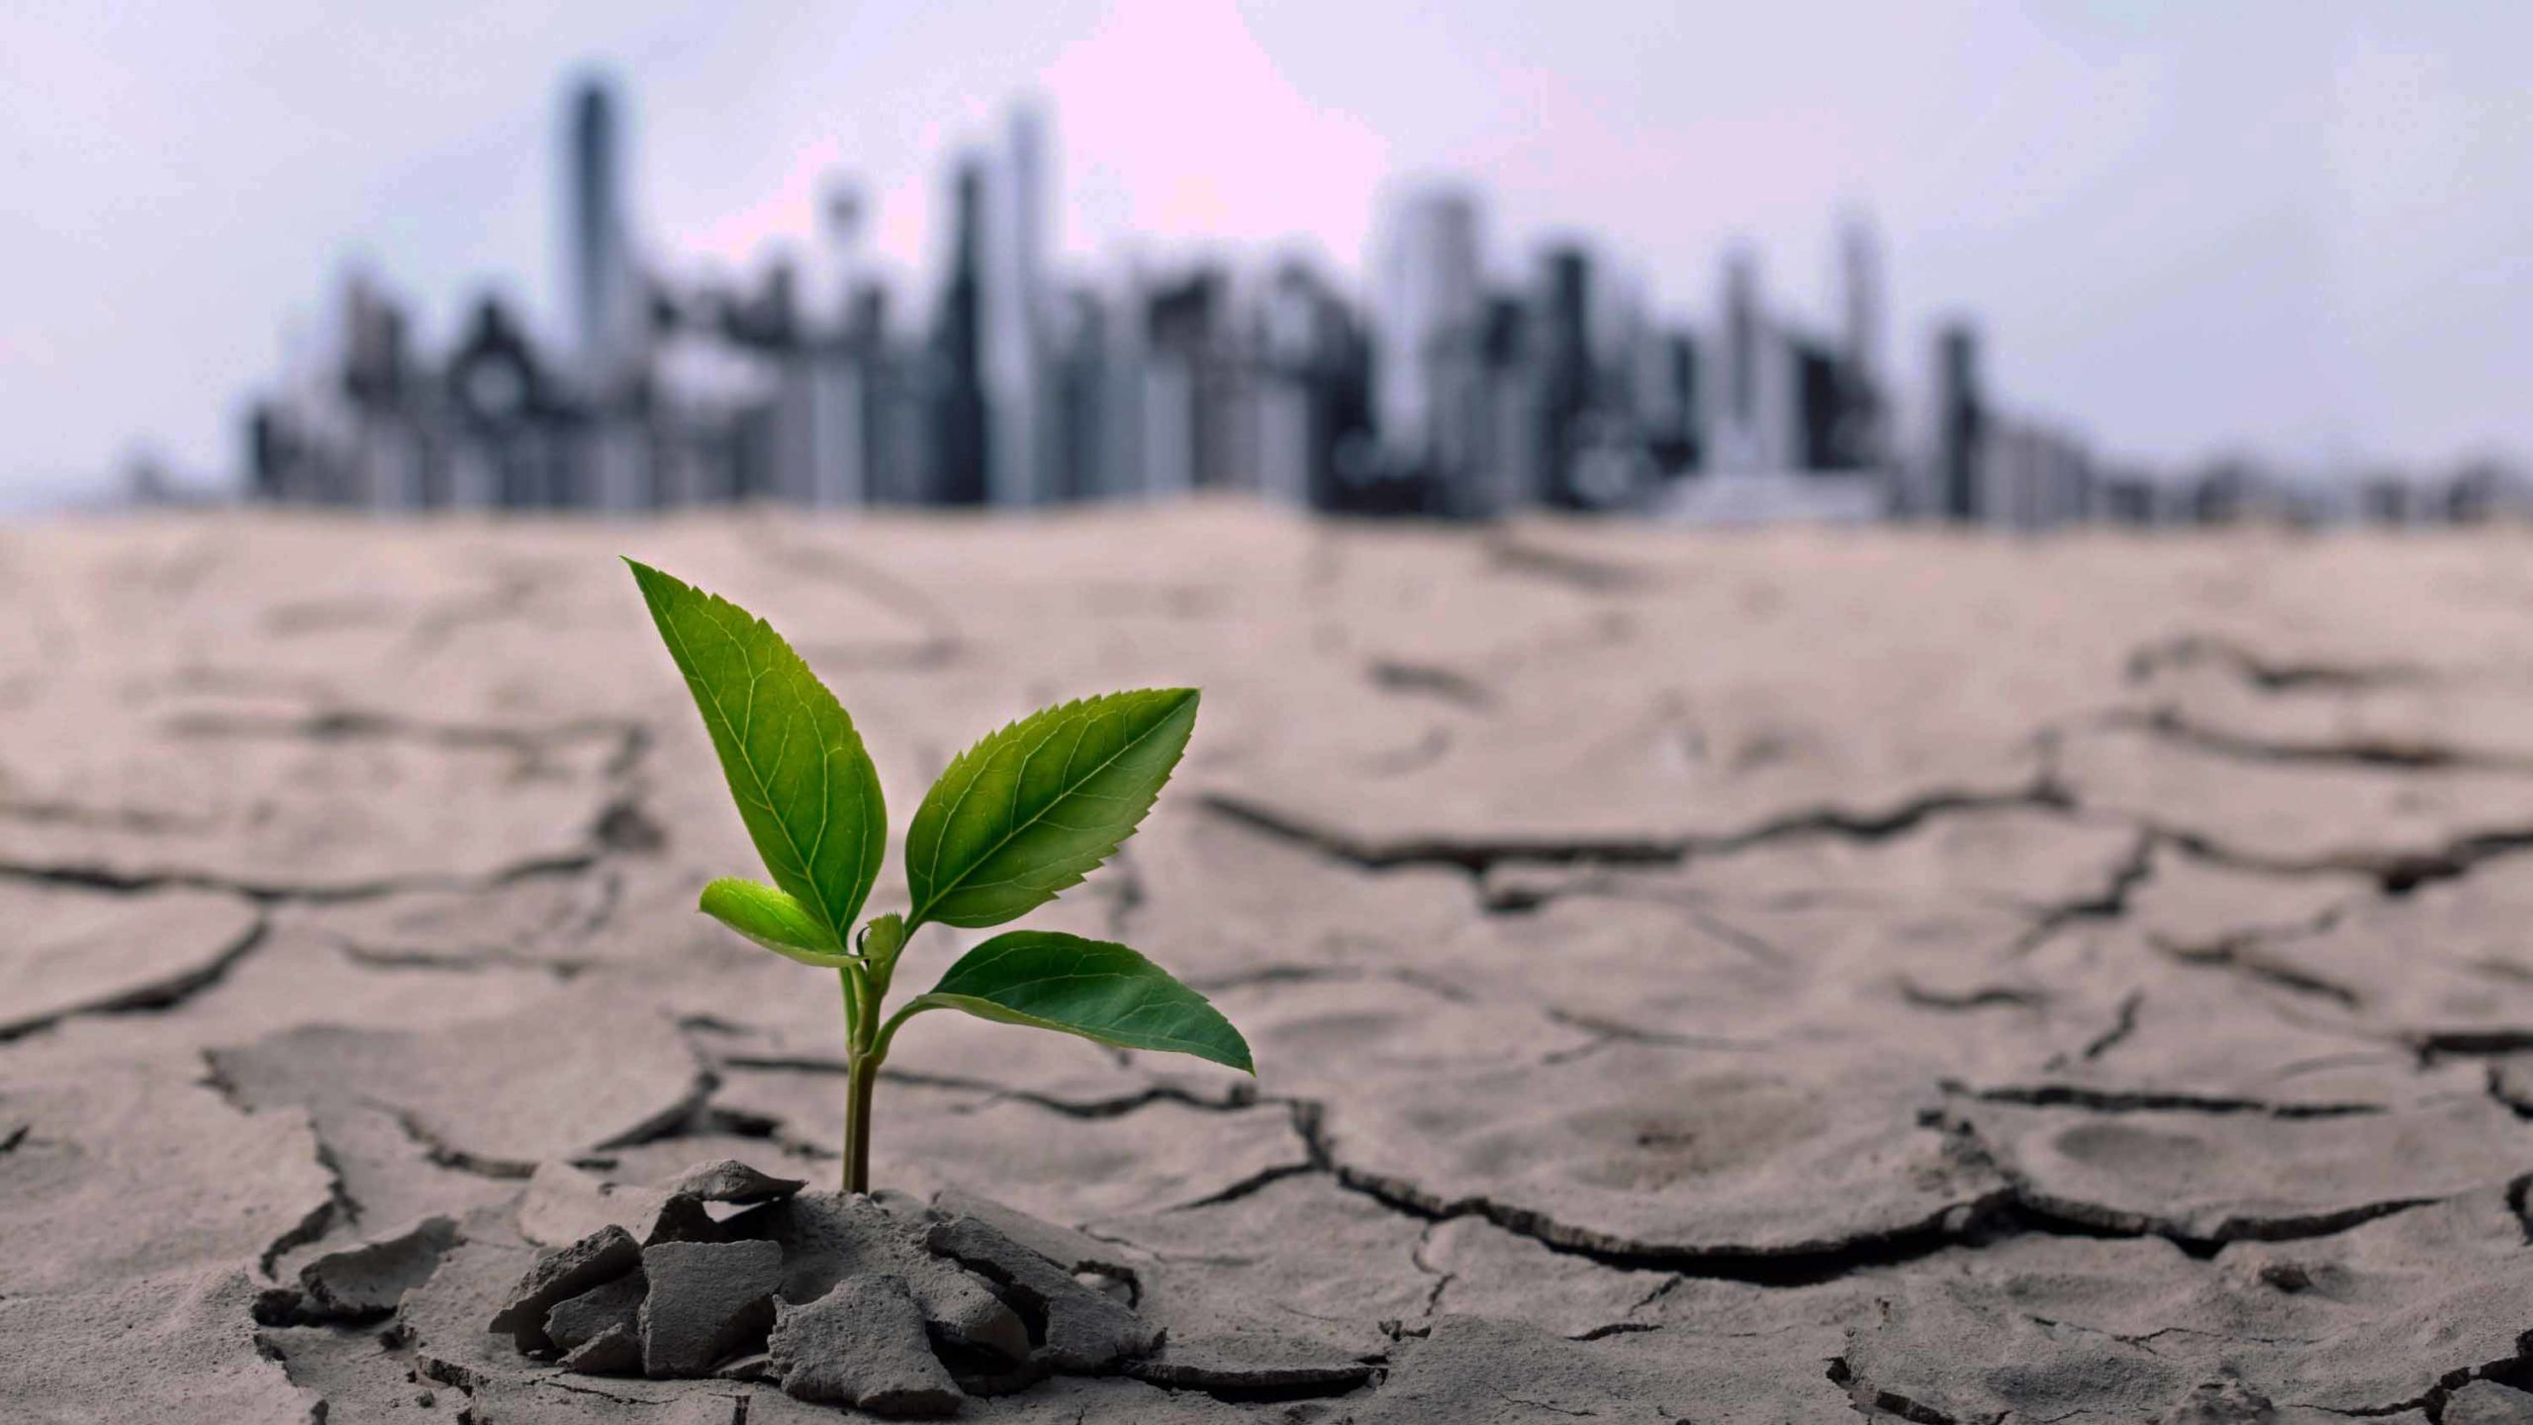
CURRENT
GLOBAL ENVIRONMENTAL CHANGE
GROUP 6

Slide 2
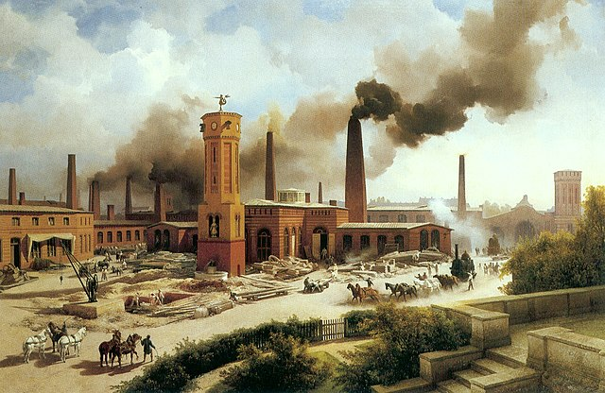
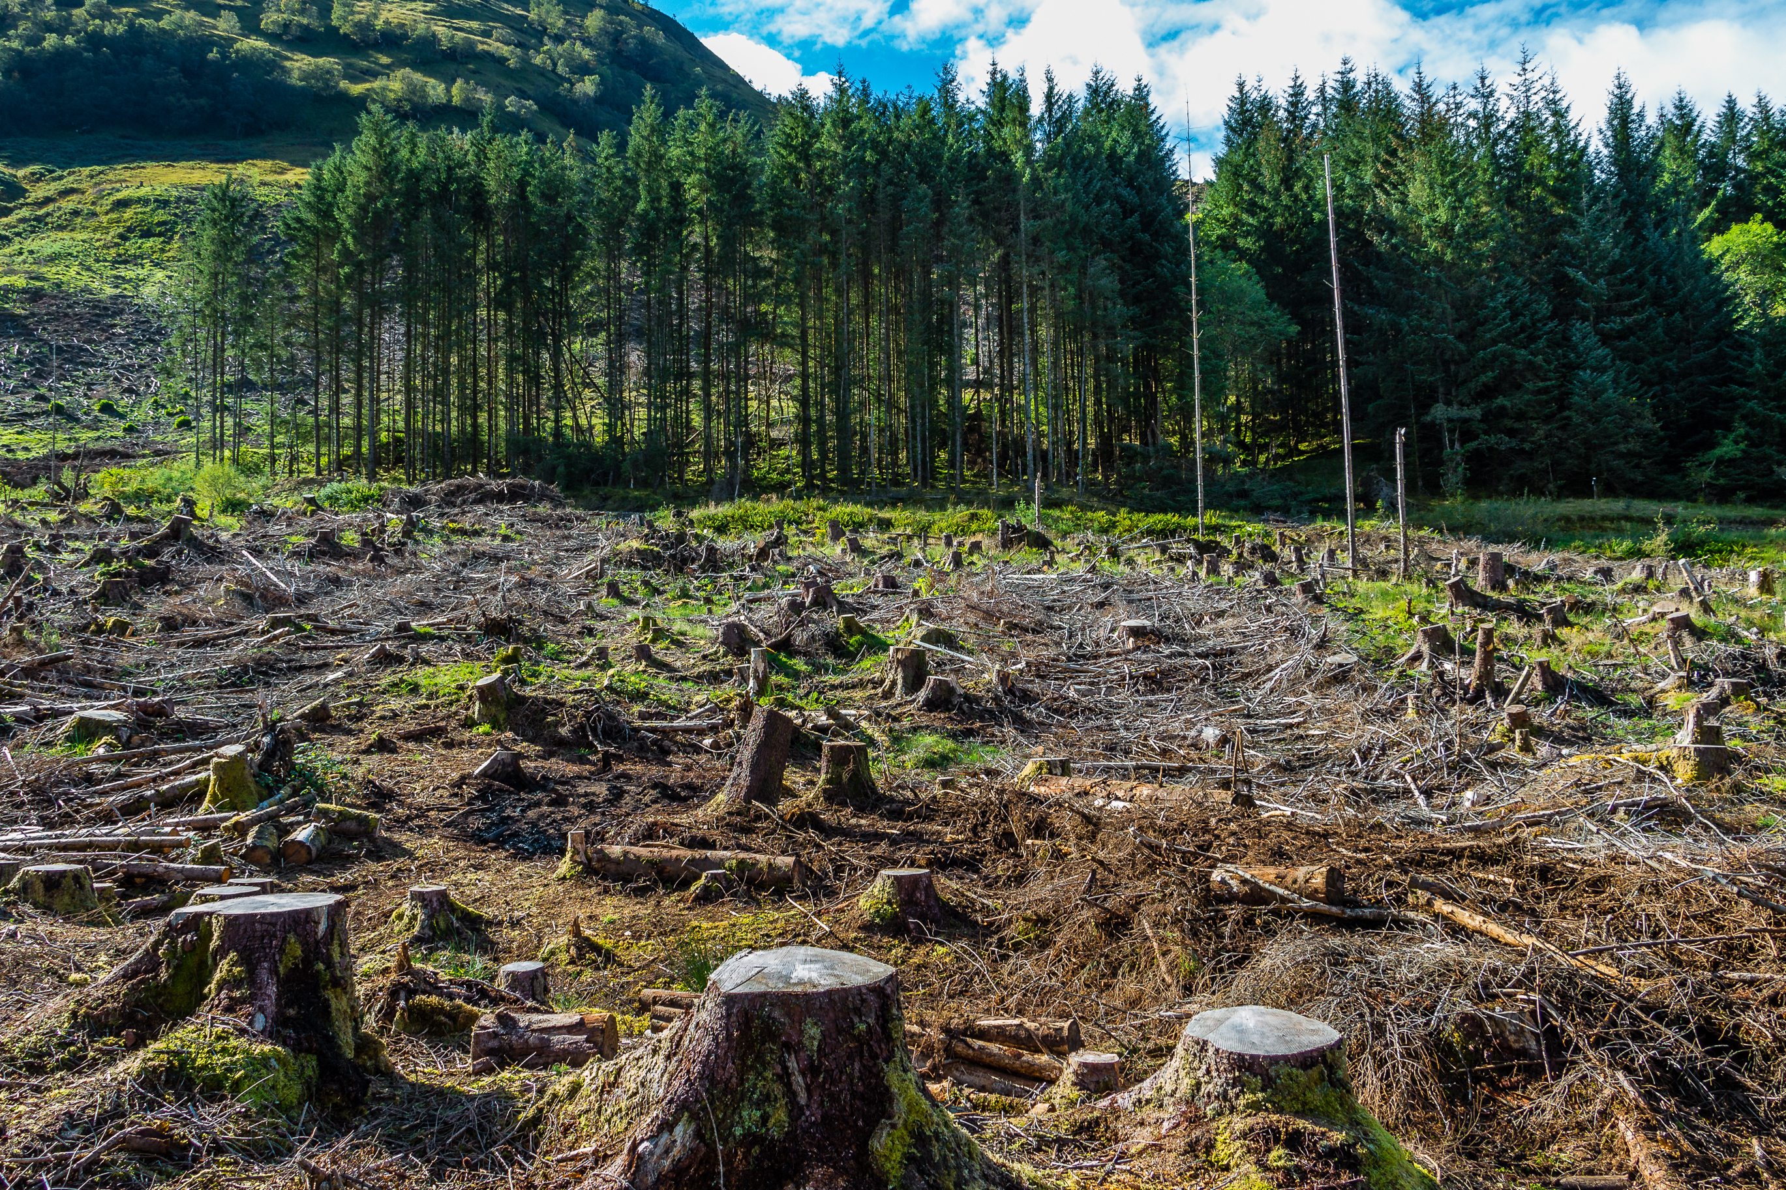
What is Global environmental change?
The significant alterations that occur in Earth’s natural system on a global scale.
Primarily driven by human activities including industrialization, deforestation, pollution etc
Industrialization
Deforestation
Pollution

Slide 3
Manifestations of Global Environmental Change
Climate Change
Pollution
Biodiversity Loss
Ocean Acidification

Slide 4
CLIMATE CHANGE

Slide 5
Long-term shifts in temperature and weather patterns.
The main greenhouse gases causing climate change are carbon dioxide and methane.
Carbon dioxide levels were triggered in the 1800s by the Industrial Revolution.
The burning of fossil fuels such as coal, oil and gas for human industry is one of the major causes.

Slide 6
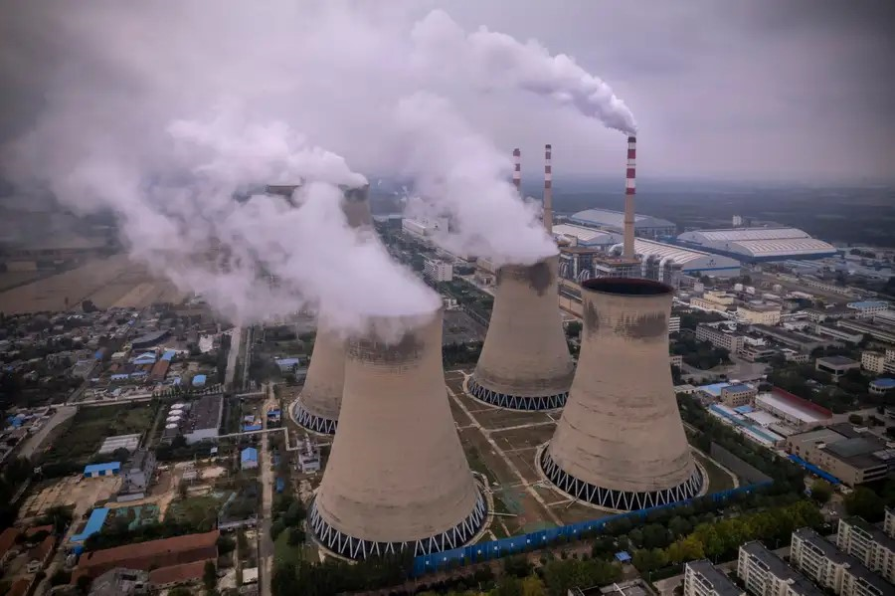
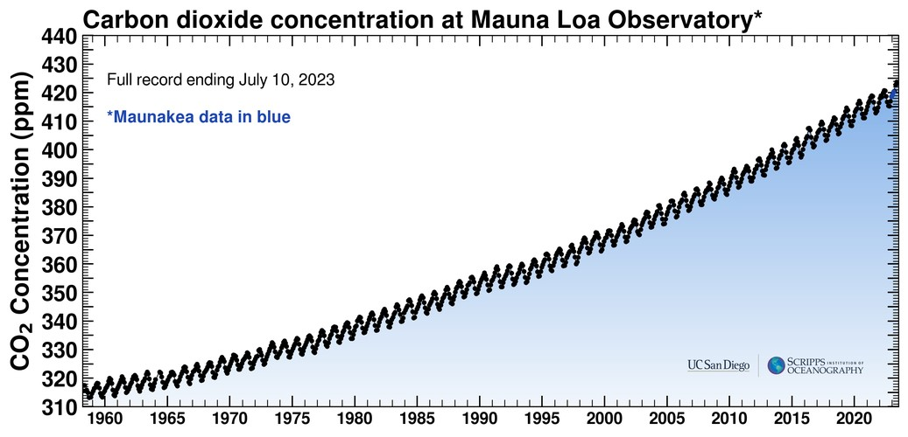
A coal power plant in Shandong province, China
CO2 concentration over the years

Slide 7
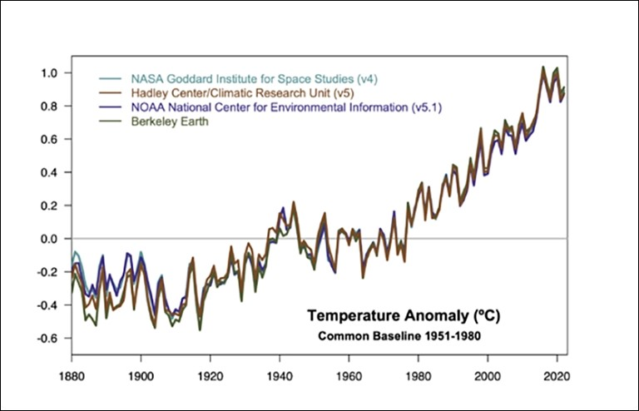
Evidence of climate change
Rising temperatures
Human activities have caused approximately 1.0˚C global warming above pre-industrial levels. At the current rate, global warming is likely to reach 1.5˚C (IPCC Annual Report)
Temperature data showing rapid warming in the past few decades

Slide 8
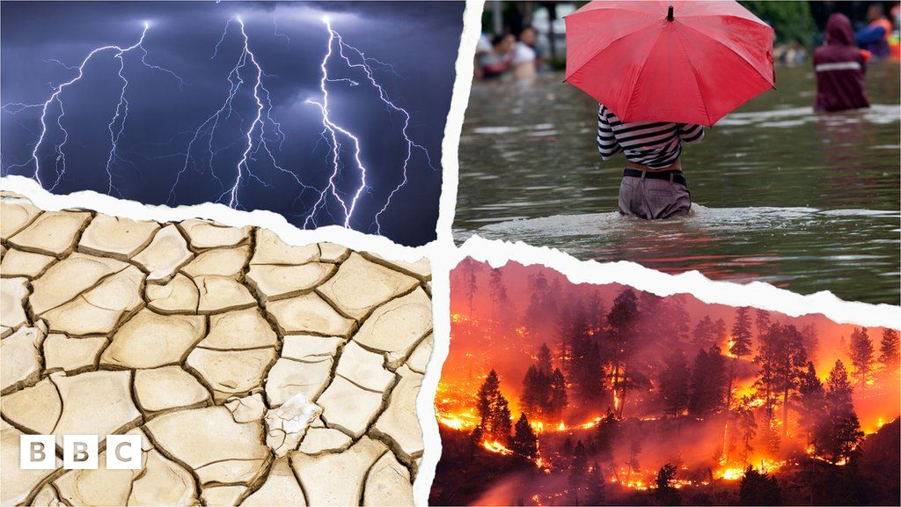
Extreme weather events
Climate change has made extreme weather events such as floods and droughts more likely and more severe (IPCC)
Extreme weather events (Credit: BBC)

Slide 9
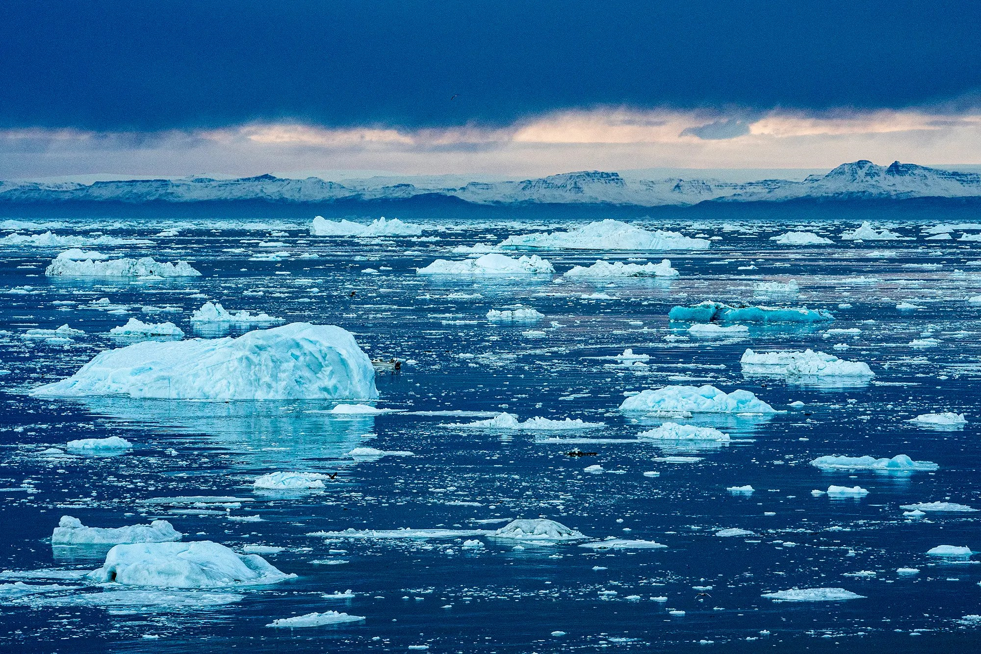
Melting glaciers and loss of ice sheets
The Arctic continues to warm more than twice as fast as the rest of the globe, with even greater warming in some locations and times of year.
The Greenland Ice Sheet experienced its 25th consecutive year of ice loss (NOAA,2022)
Glacial melting from climate change

Slide 10
“Even if we significantly curb emissions in the coming decades, more than a third of the world’s remaining glaciers will melt before the year 2100. When it comes to sea ice, 95% of the thickest and oldest ice in the arctic is already gone.”
World Wildlife Fund (WWF)

Slide 11
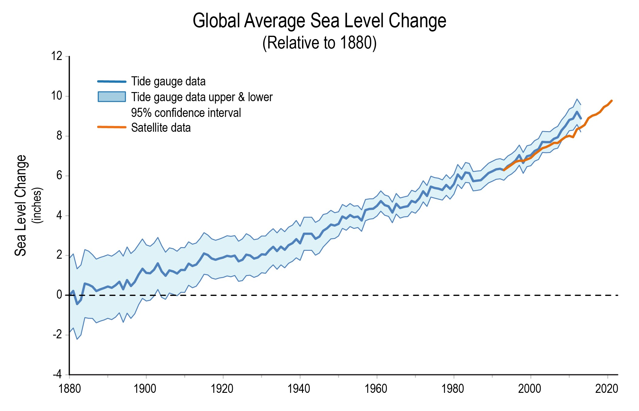
Sea level rise
The long term increase in the average height of the Earth’s ocean.
This leads to coastal erosion, salinization of freshwater source, flooding etc
Sea level is accelerating and projected to rise by a foot in 2050 (NOAA,2022)
USGCRP Indicator for change in global average sea level

Slide 12
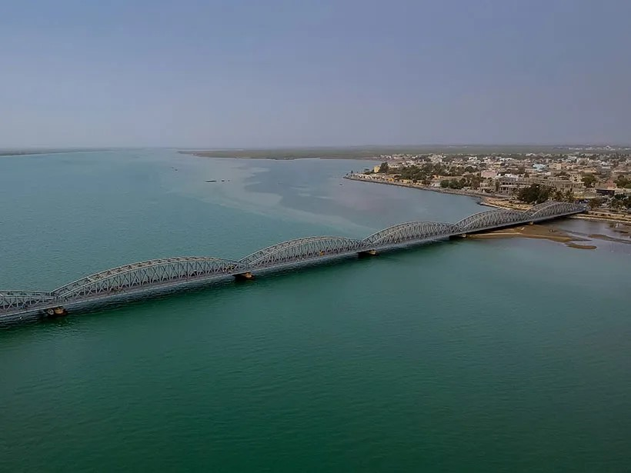
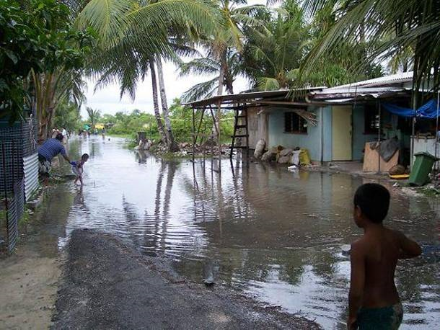
The city of Saint-Louis, threatened by rising sea levels
Constant flooding in Kiribati

Slide 13
Climate change-related disasters in 2022
Hurricane Ian
A category 4 hurricane that caused widespread damage across western Cuba and the southeast of US.
Flooding in China
In June, southern China saw its heavies rainfall since 1961, bringing floods and landslides and forcing the evacuation of hundreds of thousands of people.
Storm Eunice
Over five days in February, Storm Eunice caused devastation across Belgium, Germany, Ireland, Netherlands, Poland and the UK killing 7 people.
Drought in Brazil
Brazil had been in drought for most of the year- a drought that is thought to be the worst in decades.

Slide 14
POLLUTION

Slide 15
The introduction of harmful substances into the environment, which are called pollutants.
The types include water, air, soil, noise, light, thermal and radioactive pollution.
Soil pollution can lower agricultural production, deteriorate soil quality, and affect crops used to produce food (FAO, 2021).

Slide 16
Light pollution can cause damage to ecosystems, impede nocturnal animals normal behaviour and affect human health by interfering with circadian rhythm and sleep cycles. (IDA, 2021)
Prolonged exposure to loud noise can impair cognitive function and result in hearing, stress and sleep difficulties. (WHO, 2018)

Slide 17
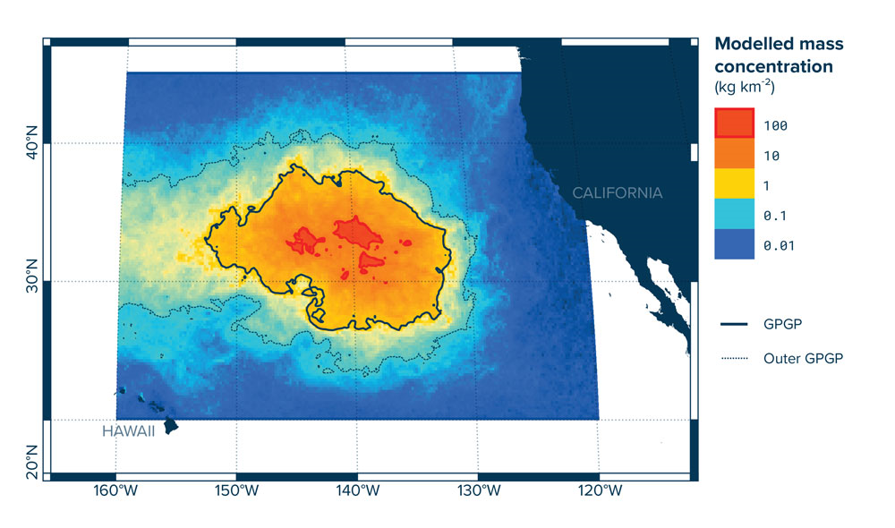
The Great Pacific Garbage Patch
the largest accumulation of ocean plastic in the world and is located between Hawaii and California.
It covers an estimated surface of 1.6 million square kilometers, an area three times the size of France.
Modelled mass concentration of the GPGP
Credit: The Ocean Cleanup

Slide 18

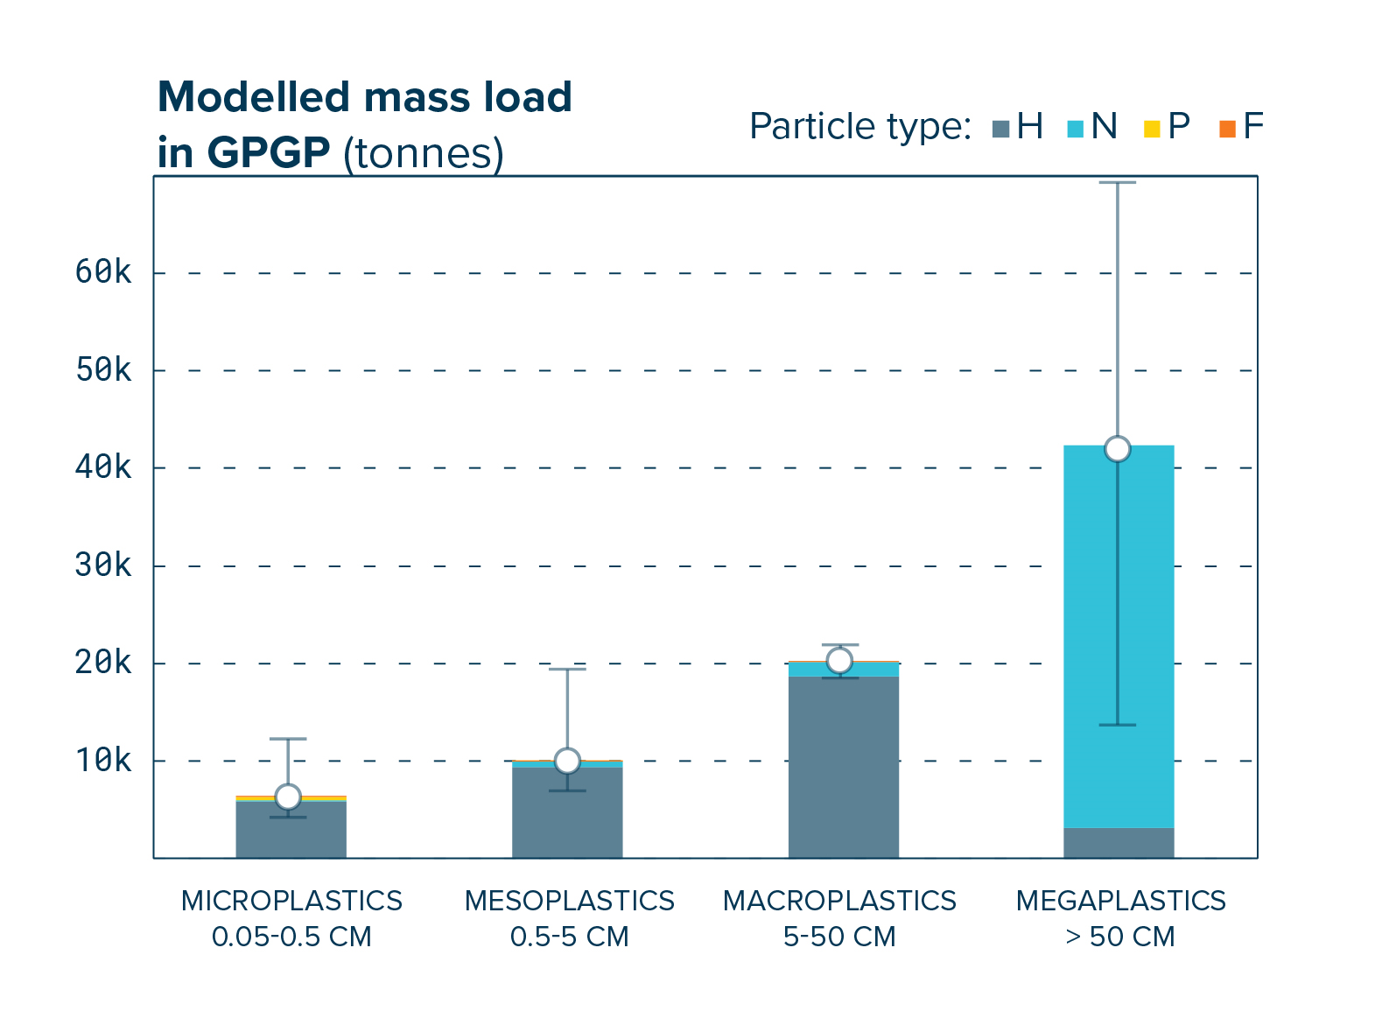
A crate found in the GPGP produced in 1977
Modelled mass load in GPGP
Source: The Ocean Cleanup

Slide 19
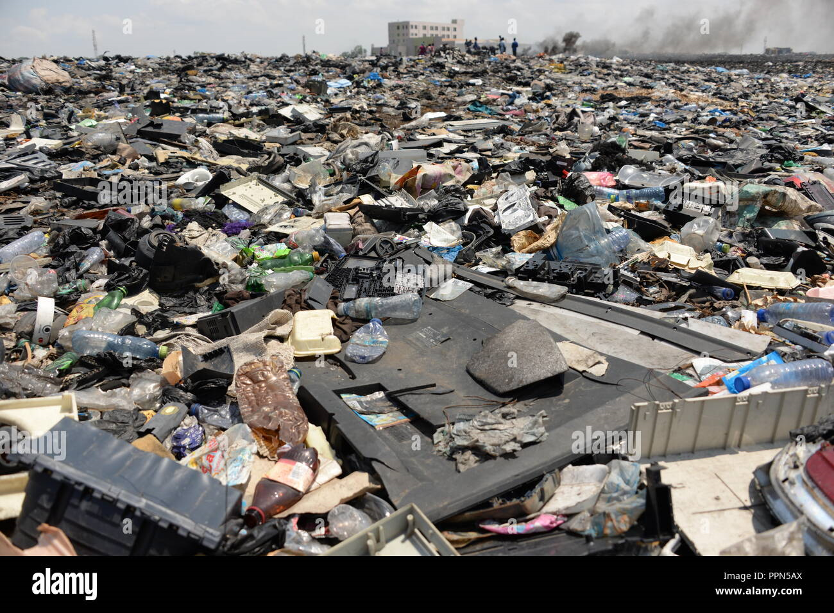
Agbogbloshie Electronic waste site
One of the largest e-waste dumping sites in the world is found in Ghana.
The burning of electronic waste releases toxic chemical such as lead, mercury and cadmium which have severe environmental and health consequences.
E-waste site at Agbogbloshie, Accra

Slide 20
The Global E-waste Statistics Partnership (2020) reported that approximately 53.6 million metric tons of electronic waste was generated worldwide in 2019.
This amount is projected to reach 74.7 million metric tons by 2030, highlighting the escalating nature of e-waste pollution.

Slide 21
Air Pollution
The WHO estimates that air pollution leads to 7 million premature deaths every year.
Out of the six common air pollutants, PM2.5, is accepted as the most harmful to human health
In 2019, only 1% of the global population lived where WHO global air quality guidelines were met.

Slide 22
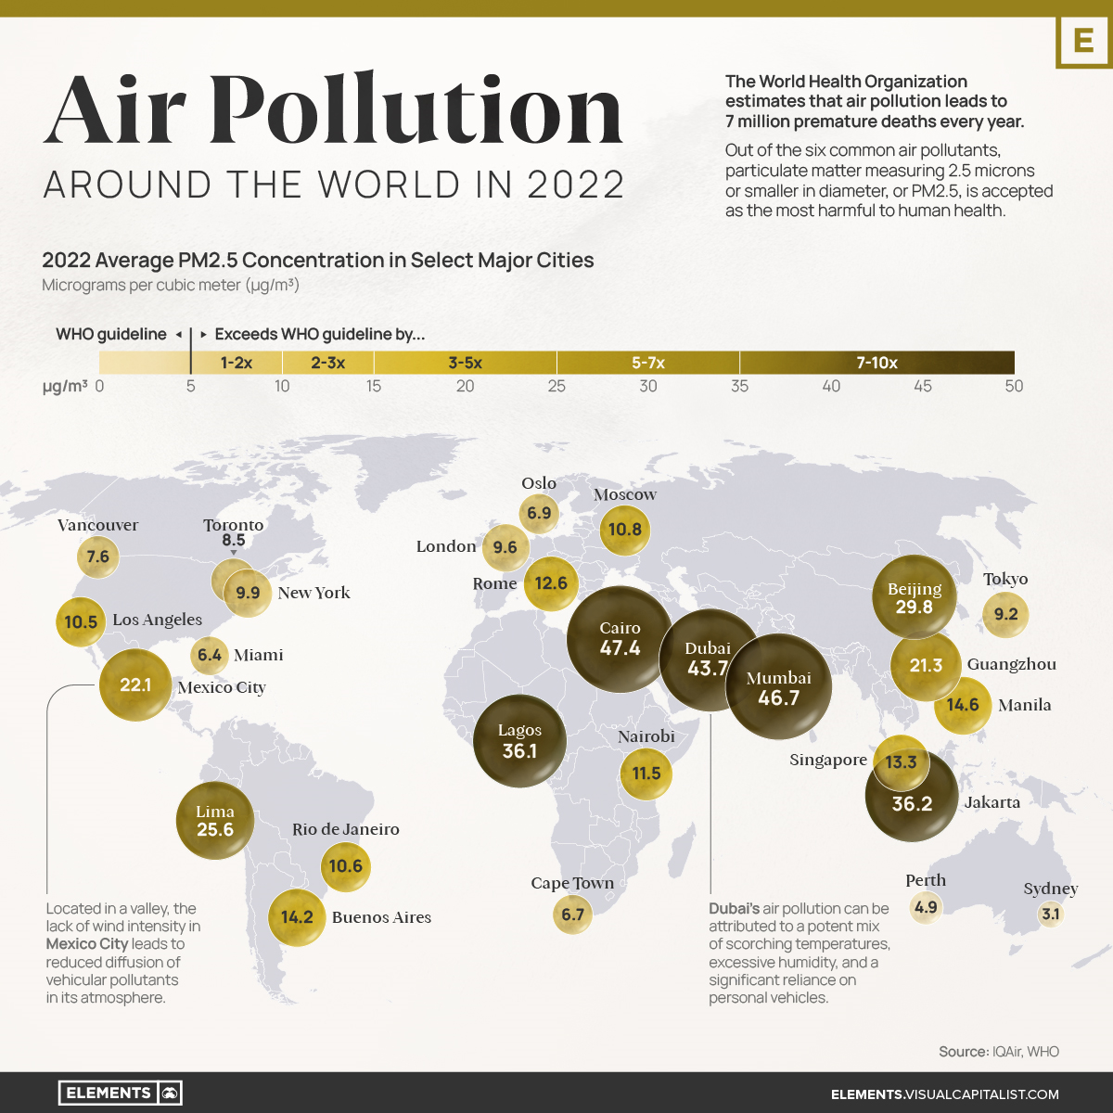
PM2.5 concentrations in selected major cities around the globe (IQAir World Air Quality Report)

Slide 23
BIODIVERSITY LOSS

Slide 24
Biodiversity loss refers to the decline in the variety and abundance of species, genes and ecosystems on Earth.
An area’s biodiversity increases and decreases with natural cycles.
Biodiversity losses from humans tend to be more severe and long-lasting.
Drivers of biodiversity loss and they are habitat loss, invasive species, overexploitation, pollution and climate change.

Slide 25
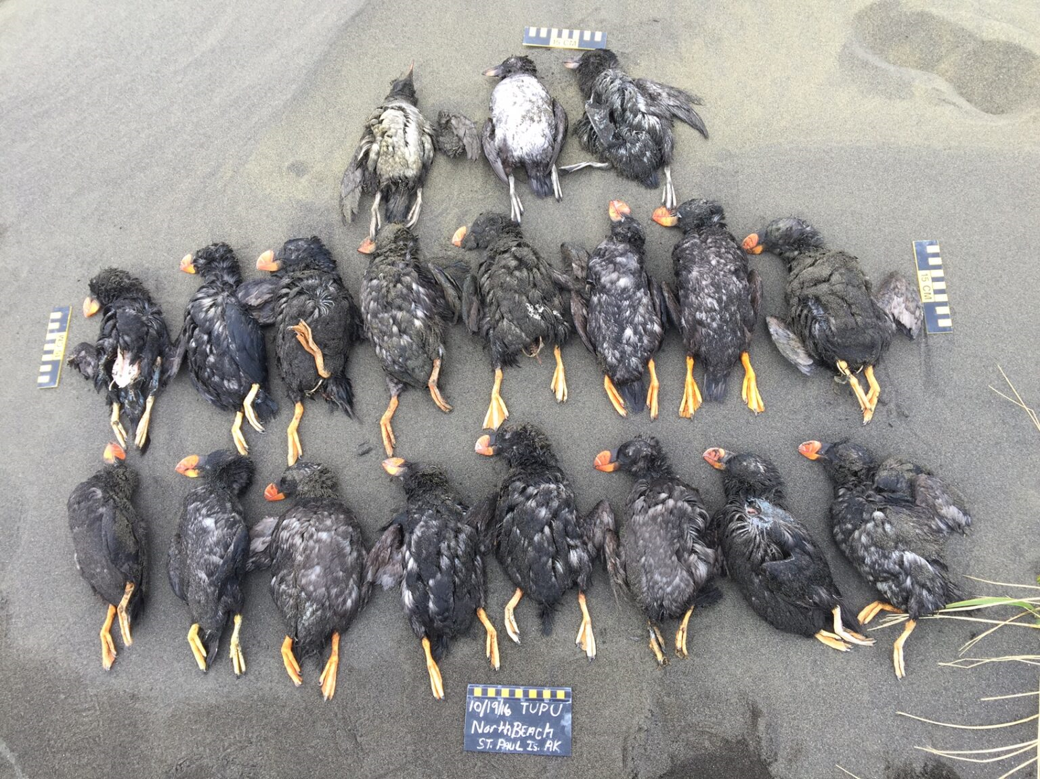
Since the 1960s, the Amazon has lost about 20% of its forest cover to deforestation and fires.
Coral reefs have declined by over half since the 1950s.
Seabirds which are indicators for marine ecosystem health are dying.
Tufted puffins from October 2016 during a massive seabird die-off (Credit: Aleut Community of St. Paul Island Ecosystem Conservation Office)

Slide 26

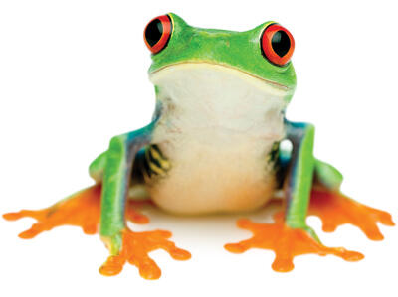
North America - 33%
Latin America and the Caribbean - 94%
Africa - 65%
Europe and Central Asia - 24%
Asia Pacific - 45%
(WWF 2020 Living Planet Report)
Biodiversity Loss Since 1970
©MICHAEL PATRICK O’NEILL/ALAMY
Elephants hunted in Africa in the 20th century for ivory
©ISTOCK.COM/BLUBERRIE
Red eyed tree frog numbers declining in Latin America

Slide 27
OCEAN ACIDIFICATION

Slide 28
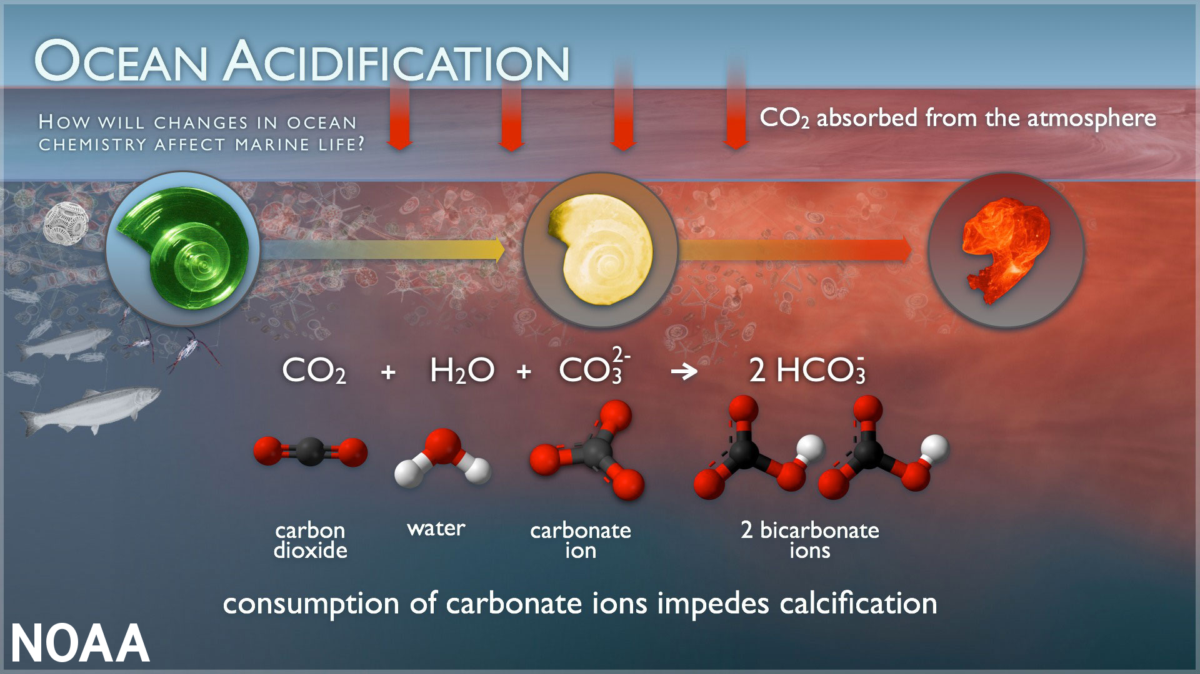
Ocean acidification is the process by which the pH of the ocean waters decreases, making them more acidic.
Primarily caused by the absorption of carbon dioxide from the atmosphere into the ocean.
Carbonate ions become less abundant.
Credit: NOAA

Slide 29
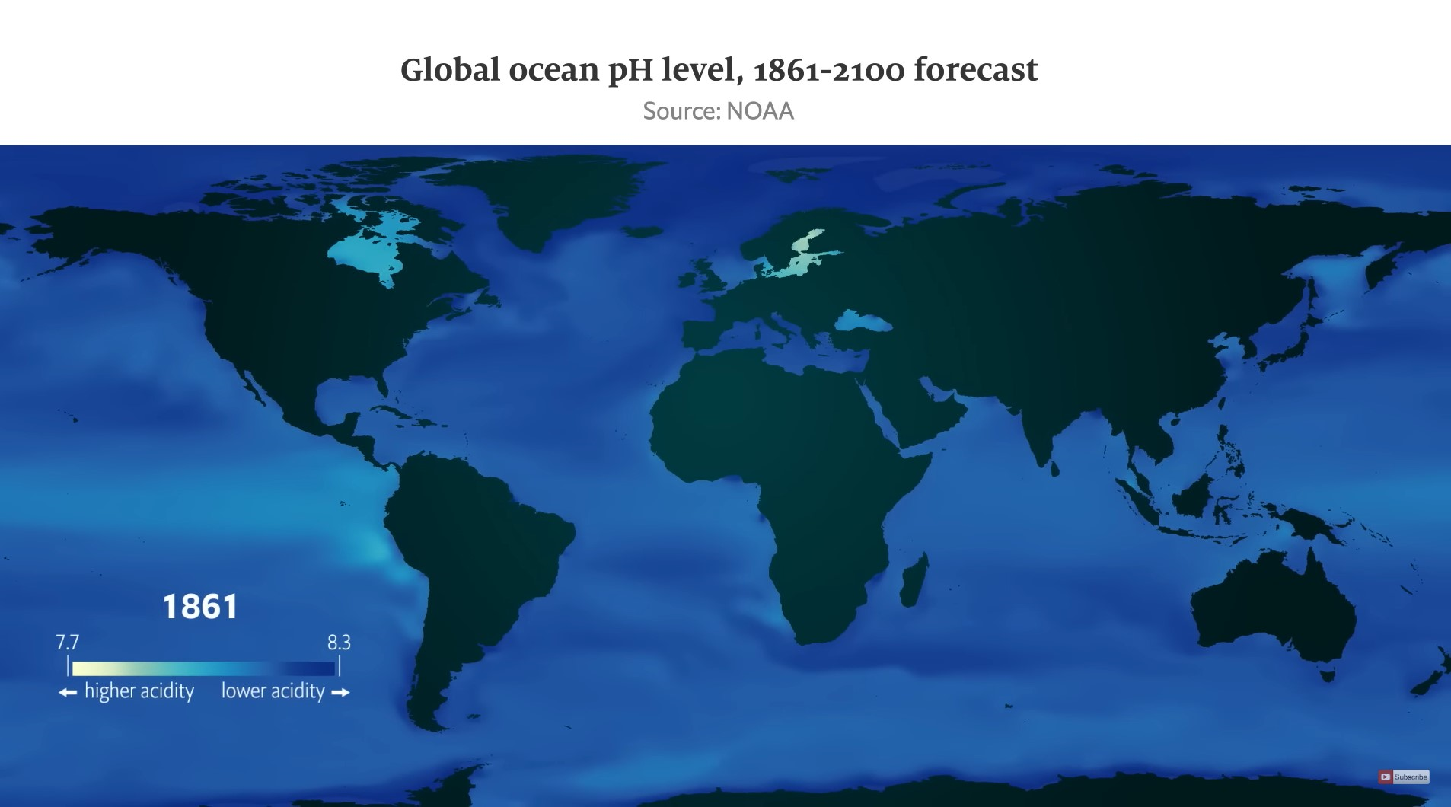
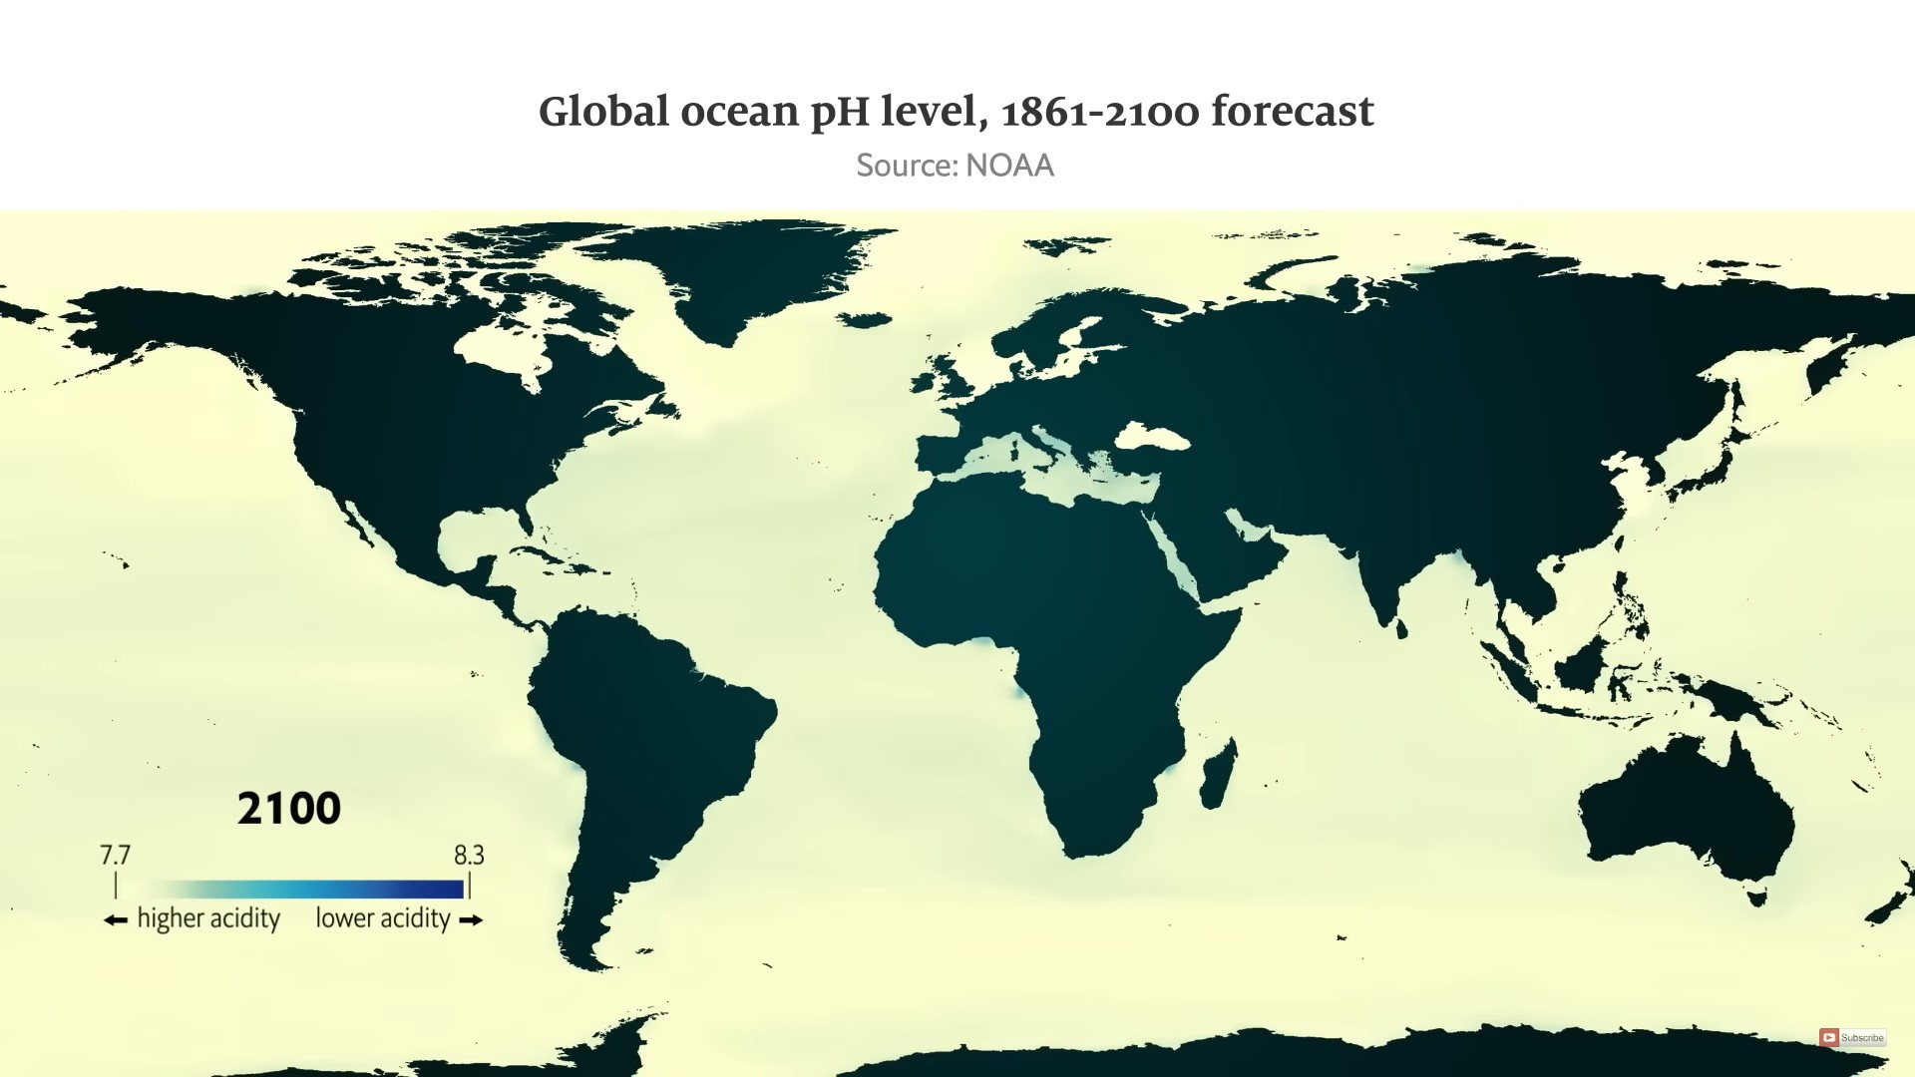
Ocean acidification was first identified in Washington State in the early 2000s.
Presently the ocean is 40% more acidic than it was in the late 1800.
By the end of this century, it is predicted to be 150% more acidic.
Credit: NOAA

Slide 30
CONCLUSION
“I really don’t believe that the planet is running out of time. Who is running out of time in the planet is only us.”
-Tatiana Bilbao

Slide 31
REFERENCES
Food and Agriculture Organization of the United Nations (FAO). (2021). Soil pollution: A hidden reality
GlobalChange.gov. “USGCRP Indicator Details.” GlobalChange.gov, 2018,
International Dark-Sky Association (IDA). (2021). What is light pollution?
Mafaranga, H. “Sea Level Rise May Erode Development in Africa.” Eos, 13 Nov. 2020,
NOAA. “Ocean Acidification.” National Oceanic and Atmospheric Administration, U.S. Department of Commerce, 1 Apr. 2020, “Report Card.” Noaa.gov, 2018, www.arctic.noaa.gov/Report-Card.
Oğuz, Selin. “Mapped: Air Pollution Levels around the World in 2022.” Visual Capitalist, 13 Apr. 2023, Scripps Institution Of Oceanography. “The Keeling Curve.” Keelingcurve.ucsd.edu, 2023,
“U.S. Coastline to See up to a Foot of Sea Level Rise by 2050 | National Oceanic and Atmospheric Administration.
World Health Organization (WHO). (2021). Ambient (outdoor) air quality and health
World Wildlife Fund. “A Warning Sign: Where Biodiversity Loss Is Happening around the World.” World Wildlife Fund, 2021,

Slide 32
THANK YOU

